Slide 1
Domain driven design

Slide 2
Introduction
Disclaimer
Presentation of Domain Driven Design based on the main books that deal with the subject and some of my personnel experience,
Target
An overview on Domain Driven Design its roots and main patterns.
Presentation of Domain Driven Design
Introduction
Model Driven Design
Architecture
DDD Strategical Patterns
DDD Tactical Patterns
References

Slide 3
Introduction to DDD

Slide 4
INTRODUCTION TO ddd
Domain Driven Design
Is a development philosophy defined by Eric Evans in his seminal work “Domain‐Driven Design: Tackling Complexity in the Heart of Software”(2003).
Provides principles, patterns, and practices to help us tackle difficult software problems and even business problems.
The ultimate goal isn't to write code, not even to build software, but to solve problems.
"People don't want to buy a quarter-inch drill. They want a quarter-inch hole!"
Theodore Levitt (legendary Harvard Business School marketing professor)
Notes:
Foret de perçage

Slide 5
Principles and practices
Focusing on the Core Domain
Learning through Collaboration
Creating Models through Exploration and Experimentation
Communication (Ubiquitous Language)
Understanding the Applicability of a Model
Constantly Evolving the Model
Notes:
The core domain is the area of the product that will give you a competitive advantage and generate real value for your business. It is vital that all of the team understand what the core domain is.
Without this collaboration and commitment from the business experts, much of the knowledge sharing will not be able to take place, and
development teams will not gain deeper insights into the problem domain. It is also true that, through collaboration and knowledge crunching, the business has the opportunity to learn much more about its domain.
Breakthroughs only occur when teams are given time to explore a model and experiment with its design. Spending time prototyping and experimenting can go a long way in helping you shape a better design. 3 bad design for one good design Eric Evans
The ability to effectively describe a model built to represent a problem domain is the foundation of DDD. This is why, without a doubt, the single most important facet of DDD is the creation of the UL. Without a shared language, collaboration between the business and development teams to solve
problems would not be effective.
Context Each model that is built is understood within the context of its subdomain and described using the UL. However, in many large models, there can be ambiguity within the UL, with different parts of an organization having different understandings of a common term or concept. DDD addresses
this by ensuring that each model has its own UL that is valid only in a certain context. Each context defines a linguistic boundary; ensuring models are understood in a specific context to avoid ambiguity in language.
Any developer working on a complex system can write good code and maintain it for a short while. However, without synergy between the source code and the problem domain, continued development will likely end up in a codebase that is hard to modify, resulting in a BBoM. DDD helps with this issue by placing emphasis on the team to continually look at how useful the model is for the current problem. It challenges the team to evolve and simplify complex models of domains as and when it gains domain insights.

Slide 6
Model driven design

Slide 7
Domain – represents the problem area you are working within.
Domain model - It represents a view, not the reality, of the problem domain designed only to meet the needs of business use cases.
Analysis model - is a collection of artifacts that describe the model of a system.
Code model - is the realization of the analysis model
Notes:
Domain Model - The domain model only exists to help us solve problems; in order to be effective it needs to have clarity and be free of technical complexities. It is described in a shared language that the team speaks and the diagrams that the team sketches. When it is expressed as a code implementation, it is bound to the analysis model through the use of the shared language. Its usefulness comes from its ability to represent complex logic and polices in the domain to solve business use cases. The model contains only what is relevant to solve problems in the context of the application being created. It needs to constantly evolve with the business to keep itself useful and valid.
Analysis Model - These artifacts can be anything from cigarette packet sketches to informal UML. The analysis model exists to help both the development teams and business users to understand the problem domain; it is not a blueprint for the technical implementation.
The Code Model Is the Primary Expression of the Domain Model, The code and business models are kept in synergy. The code is the model; the code is the truth.

Slide 8
Domain vs. Domain model
The problem space
The solution space
Domain
Domain model
A Projection of the
Real Domain
The reality
An abstraction of reality designed to manage complexity for specific business cases
Notes:
The usefulness of the domain model comes in its ability to represent complex logic and polices in the domain to solve business problems and not how well it reflects reality. It also exists in a more abstract space: in the language the team speaks and the diagrams it sketches. The model is built from the collaboration between the development team and the business

Slide 9
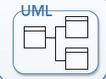
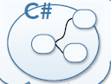

Ubiquitous Language (UL)
Keep code model clean of technical concerns
Analysis model not to abstract
The two models are bound by the ubiquitous language
Ubiquitous Language
Communication happens because of the ubiquitous
language
Domain Experts
Development Team
Notes:
DDD emphasizes the need to keep the code model, the implementation, in close synergy with the analysis model, the design. This synergy is achieved by ensuring both models are described and share the UL,
To achieve this, it is crucial to keep the code model clean of technical concerns and focused on the domain. In turn, it is important
to have an analysis model that can be implemented—not too abstract or high level to be of any use.

Slide 10
DDD and model driven design
Model‐Driven Design is the process of binding an analysis model to a code implementation model ensuring that both stay in sync and are useful during evolution.
Model‐Driven Design differs from DDD in that it is focused on implementation.
DDD focuses on language, collaboration, and domain knowledge.
The two complement each other.
Notes:
MODEL-DRIVEN DESIGN discards the dichotomy of analysis model and design to search out a single model that serves both purposes. Setting aside purely technical issues, each object in the design plays a conceptual role described in the model. This requires us to be more demanding of the chosen model, since it must fulfill two quite different objectives.
The two complement each other; a; Model‐Driven Design approach enables domain knowledge and the shared language to be incorporated into a software model that mirrors the language and mental models of the business experts

Slide 11
Architecture Isolating the domain

Slide 12
Architecture – isolating the domain
Developing software while following the principles of DDD does not require to use any particular application architecture style.
But, one thing that architecture must support is the isolation of your domain logic.
Separating the Concerns of the Application: allow separate evolution of presentation, persistence, and domain logic concerns of an application.
Abstraction from the Complexities of the Domain: exposing a coarse-grained set of use cases that encapsulate and hide the low-level domain details.
Notes:
Abstracting at a higher level prevents changes in domain logic from affecting the presentation layer and vice versa because the clients of the application communicate through application services acting as use cases rather than directly with domain objects.

Slide 13
Architecture – classical Layered architecture
Presentation Layer - Responsible for showing information to the user and interpreting the user’s commands.
Application Layer - Defines the jobs the software is supposed to do and directs the expressive domain objects to work out problems.
Domain Layer (or Model Layer) - Responsible for representing concepts of the business, information about the business situation, and business rules. This layer is the heart of business software.
Infrastructure Layer - Provides generic technical capabilities that support the higher layers: message sending for the application, persistence for the domain, drawing widgets for the UI, and so on.
Notes:
PresL The external actor might sometimes be another computer system rather than a human user.
App Layer, The tasks this layer is responsible for are meaningful to the business or necessary for interaction with the application layers of other systems. This layer is kept thin. It does not contain business rules or knowledge, but only coordinates tasks and delegates work to collaborations of domain objects in the next layer down. It does not have state reflecting the business situation, but it can have state that reflects the progress of a task for the user or the program.
Domain Layer, State that reflects the business situation is controlled and used here, even though the technical details of storing it are delegated to the infrastructure.
Infr Layer.

Slide 14
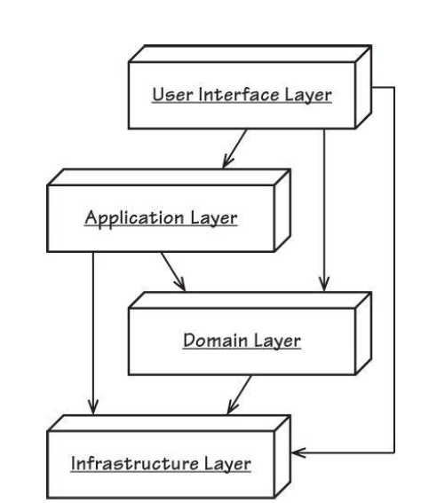
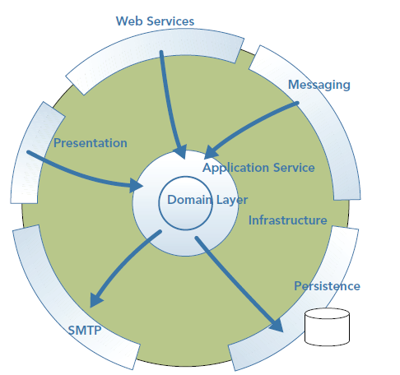
Architecture – classical Layered architecture

Slide 15
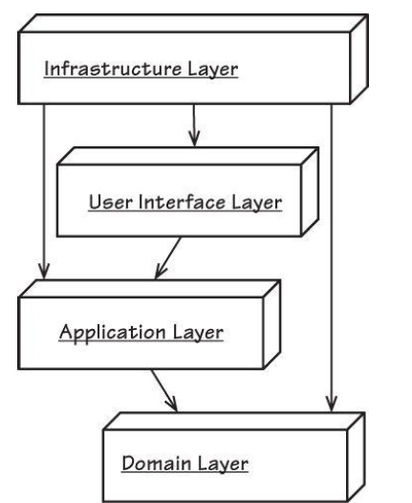
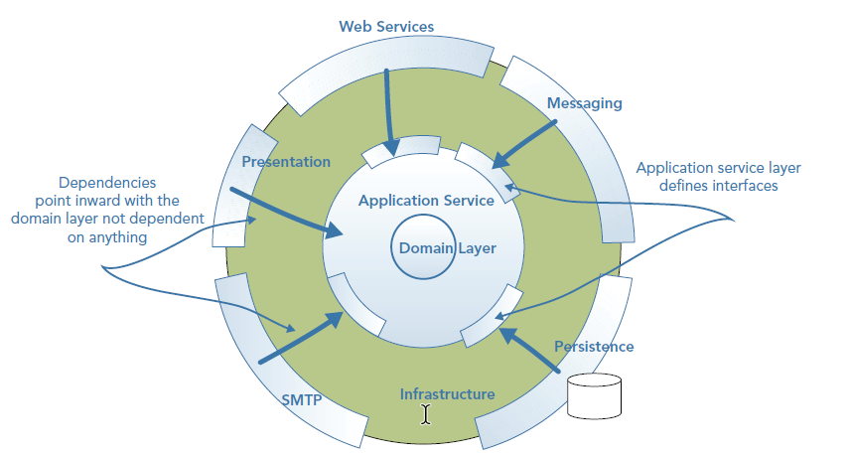
dependency inversion architecture
Notes:
To enforce a separation of concerns, the domain layer and application layers at the center of the architecture should not depend on any other layers. All dependencies face inward, in that the domain layer, at the heart of the application, is dependent on nothing else, enabling it to focus distraction-free on domain concerns.
The application layer is dependent only on the domain layer; it orchestrates the handling of the use cases by delegating to the domain layer.
Of course, the state of domain objects needs to be saved to some kind of persistence store. To achieve this without coupling the domain layer to technical code, the application layer defines an interface that enables domain objects to be hydrated and persisted. This interface is written from the perspective of the application layer and in a language and style it understands free from specific frameworks or technical jargon.
The infrastructural layers then implement and adapt to these interfaces, thus giving the dependency that the lower layers need without coupling. Transaction management along with cross-cutting concerns such as security and logging are provided in the same manner.

Slide 16
Architecture
The Domain Layer Is Where the Model Lives.
LAYERED ARCHITECTURE is used in most systems today, under various layering schemes. However, domain-driven design requires only on particular layer to exist.
Many other architectures support the separation of concerns by dividing an application into areas that change together, such as : Uncle Bob’s Clean Architecture, The Hexagonal Architecture (also known as the Ports and Adapters Architecture), The Onion Architecture.
When communicating across layers, to prevent exposing the details of the domain model se simple data transfer objects (DTOs), presentation models, and application event objects to communicate changes or actions in the domain.

Slide 17
strategical patterns

Slide 18
Strategic distillation
Strategic distillation of the domain model :
Aids all team members in grasping the overall design of the system and how it fits together
Facilitates communication by identifying a core model of manageable size to enter the UBIQUITOUS LANGUAGE.
Guides refactoring.
Focuses work on areas of the model with the most value.
Guides outsourcing, use of off-the-shelf components, and decisions about assignments

Slide 19
STRATEGICAL PATTERNS
Core domain – is made by those parts of the model distinctive and central to the purposes of the intended applications.
Generic domain – These subdomains aren’t core to the business, but the business can’t operate without them.
Supporting Domains - subdomains that, although not defining what your system does, help to support your core domains.
Domain Vision Statement - capture what is central to the success of the software, what the business goal is, and where the value is.
Notes:
The CORE DOMAIN is where the most value should be added in your system. Boil the model down. Find the CORE DOMAIN and provide a means of easily distinguishing it from the mass of supporting model and code. Bring the most valuable and specialized concepts into sharp relief. Make the CORE small.
An example of a generic domain is an e‐mail sending service, an accounts package, or a report suite. Because these subdomains aren’t core and won’t give you a competitive edge, it doesn’t make sense to spend a lot of effort or investment in building them. Instead, look to buy in software for generic domains. Alternatively, use junior developers to build these systems, freeing up more experienced resources to work on what’s core to your business.
Supporting Domain, For example, Amazon’s supporting domains would be the functionality that enables a customer to browse a catalog for products. Amazon’s product‐browsing functionality doesn’t define it as a company, and neither is it that different from any other e‐commerce site, but it does support the tracking of user journeys to feed a recommendations engine.
Write a short description (about one page) of the CORE DOMAIN and the value it will bring, the "value proposition." Ignore those aspects that do not distinguish this domain model from others. Show how the domain model serves and balances diverse interests. Keep it narrow. Write this statement early and revise it as you gain new insight.

Slide 20
STRATEGICAL PATTERNS
Bounded context – delimits the applicability of a particular model so that team members have a clear and shared understanding of what has to be consistent and how it relates to other CONTEXTS.

Slide 21
Strategical patterns
A Domain with Subdomains and Bounded Contexts
Invoicing subdomain
External Forecasting System
Inventory subdomain
e-Commerce System
Order subdomain
Inventory System
Shipping subdomain
Product catalog subdomain

Slide 22
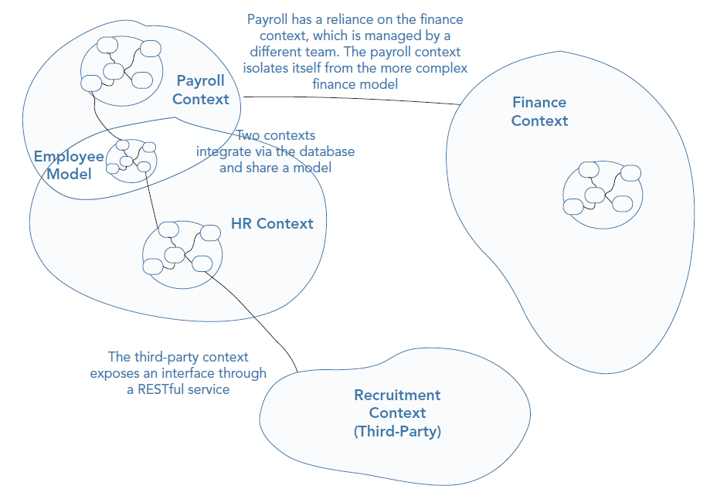
STRATEGICAL PATTERNS
A context map - reflects the way things are right now. It provides a holistic view of the technical integration methods and relationships between bounded contexts.

Slide 23
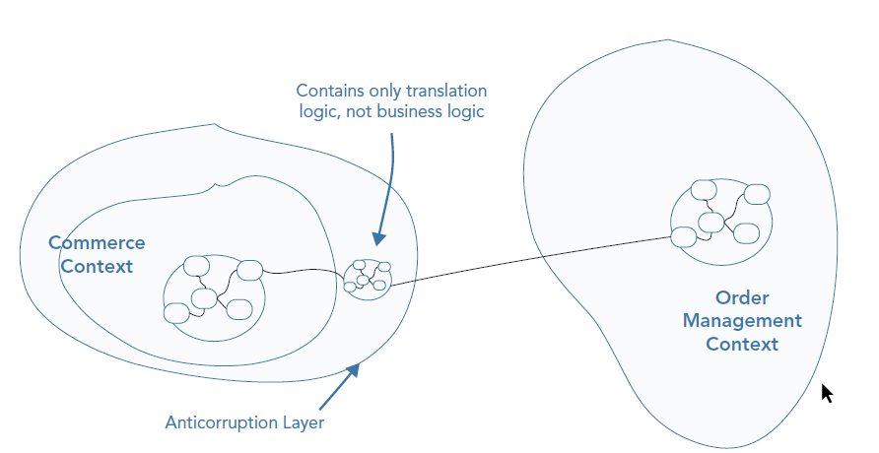
STRATEGICAL PATTERNS
Anticorruption layer- provides isolation for a model when interfacing with another context. Integrates code that you don’t’ own or can’t change?

Slide 24
STRATEGICAL PATTERNS
Shared kernel- sharing part of the model and associated code between teams
Payroll context
Human resources context
The employee model is common to both contexts and so it is shared
Notes:
If two teams are working closely in the same application, on two separate bounded contexts that have a lot of crossover in terms of domain concepts and logic, the overhead of keeping the teams isolated and using translation maps to translate from one context to another can be too much. In this instance, it may be better to collaborate and to share part of the model to ease integration. This shared model is known as a shared kernel. The pattern is of particular use if you have two bounded contexts in the same subdomain that share a subset of domain logic.

Slide 25
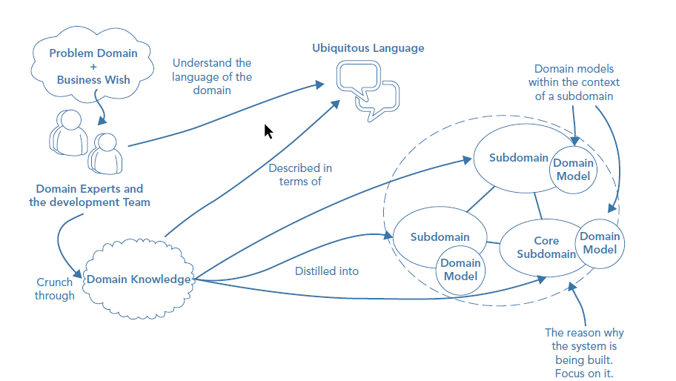
ddd PATTERNS – problem space

Slide 26
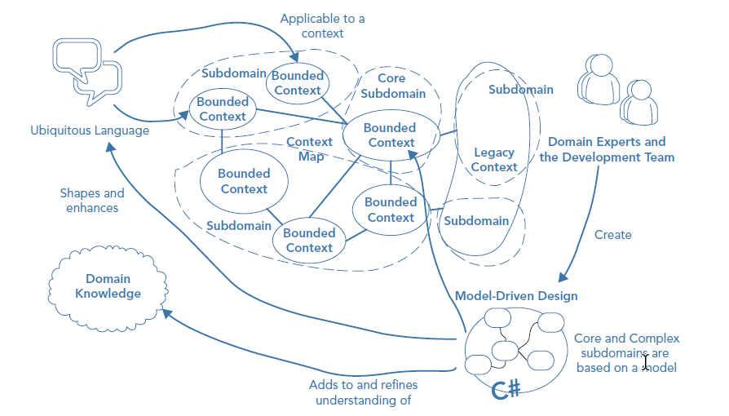
ddd PATTERNS – solution space

Slide 27
Tactical patterns

Slide 28
Tactical patterns
Navigation map of the language of MODEL-DRIVEN-DESIGN
DOMAIN SERVICIES
Access with
REPOSITORIES
DOMAIN EVENTS
Push state changes with
EVENT
SOURCES
Access with
Access with
Express model with
Express changes with
AGGREGATES
Access with
Acts as root of
ENTITIES
Encapsulate with
Encapsulate with
MODEL DRIVEN DESIGN
Express identity with
Encapsulate with
Encapsulate with
FACTORIES
Express states & computation with
VALUE OBJECTS
Encapsulate with

Slide 29
Tactical patterns
The role of the tactical patterns is to manage complexity and ensure clarity of behavior within the domain model.
Designed to have single responsibility.
Ubiquitous Language (UL) for developers for constructing the domain model.

Slide 30
Tactical patterns
Patterns to model the domain - represent the policies and logic within the problem domain.
Express relationships between objects, model rules, and bind the detail of the analysis model to the code implementation model.
Express the elements of the model in code.
Lifecycle patterns - deal with the creation and persistence of the objects that represent the structure of the domain.
Emerging patterns – Two patterns emerged after Eric Evans’ original text : Domain Events, Events Sourcing,

Slide 31
Tactical patterns
Patterns to model the domain (1/2)
Entities (a.k.a. Reference objects) – a domain concept is designed as entity when we care about it’s individuality.
Value objects – represent the elements or concepts of the domain that are known only by their characteristics.
Association (a.k.a. Relationship) – represent a relationship between domain concepts.
Notes:
Entities - are not fundamentally defined by their attributes, but rather by a thread of continuity and identity.
Value Objects – VALUE OBJECTS are instantiated to represent elements of the design that we care about only for what they are, not who or which they are. Make it express the meaning of the attributes it conveys and give it
related functionality. Treat the VALUE OBJECT as immutable. Don't give it any identity and avoid the design complexities necessary to maintain ENTITIES. Examples : Colors

Slide 32
Tactical patterns
Patterns to model the domain (2/2)
Domain services – encapsulate domain logic and concepts that are not naturally modelled as values objects or entities in the model.
Modules (a.k.a. Packages) – organize and encapsulate related concepts (entities and value objects) to simplify the understanding of larger domain models. Modules are used to decompose the domain model.
Notes:
Domain services - Domain services have no identity or state; their responsibility is to orchestrate business logic using entities and value objects. When a significant process or transformation in the domain is not a natural responsibility of an ENTITY or VALUE OBJECT, add an operation to the model as a standalone interface declared as a SERVICE. Define the interface in terms of the language of the model and make sure the operation name is part of the UBIQUITOUS LANGUAGE. Make the SERVICE stateless.
A Service in the domain is a stateless operation that fulfills a domain-specific task. Often the best indication that you should create a Service in the domain
model is when the operation you need to perform feels out of place as a method on an Aggregate (10) or a Value Object (6). To alleviate that uncomfortable
feeling, our natural tendency might be to create a static method on the class of an Aggregate Root. However, when using DDD, that tactic is a code smell that
likely indicates you need a Service instead.
Modules in model serve as named containers for domain object classes that are highly cohesive with one another. The goal should be low coupling between the classes that are in different Modules. Choose MODULES that tell the story of the system and contain a cohesive set of concepts. This often yields low coupling between MODULES, but if it doesn't, look for a way to change the model to disentangle the concepts, or search for an overlooked concept that might be the basis of a MODULE that would bring the elements together in a meaningful way. Seek low coupling in the sense of concepts that can be understood and reasoned about independently of each other. Refine the model until it partitions according to highlevel domain concepts and the corresponding code is decoupled as well.
Give the MODULES names that become part of the UBIQUITOUS LANGUAGE. MODULES and their names should reflect insight into the domain.

Slide 33
Tactical patterns
The lifecycle of the object domain patterns (1/2)
Aggregates – a way to cluster a graph of closely related objects under a
common parent (root). The purpose is to ensure consistency and concurrency.
Factories – provide encapsulation when creation of an object, or an entire AGGREGATE, becomes complicated or reveals too much of the internal structure.
Notes:
It is difficult to guarantee the consistency of changes to objects in a model with complex associations. Invariants need to be maintained that apply to closely related groups of objects, not just discrete objects. Yet cautious locking schemes cause multiple users to interfere pointlessly with each other and make a system unusable.
Aggregates, entities, and value objects can become complex when you’re creating a domain model for large and rich domains. If intimate knowledge is required to ensure valid instances of a dependent object are created, it can cloud the expressiveness of the domain. The knowledge of other objects’ invariants breaks the Single Responsibility Principle (SRP). It is recommended that you separate use from construction and explicitly encapsulate creation logic within a factory object if it is complex or if it can be expressed better. Object creation is not a domain concern, but it does live within the domain layer of an application. You will rarely talk about factories to domain experts, but they do play an important role.
Of all the patterns used in DDD, Factory is probably one of the better known. Highly publicized in Design Patterns [Gamma et al.] are Abstract Factory, Factory Method, and Builder.
Consider the primary motivations for using Factories: Shift the responsibility for creating instances of complex objects and AGGREGATES to a separate object, which may itself have no responsibility in the domain model but is still part of the domain design. Provide an interface that encapsulates all complex assembly and does not require the client to reference the concrete classes of the objects being instantiated. Create entire AGGREGATES as a piece, enforcing their invariants. [Evans, p. 138]

Slide 34
Tactical patterns
The lifecycle of the object domain patterns (2/2)
Repository – is used to manage aggregate persistence and retrieval while ensuring that there is a separation between the domain model and the data model. It mediates between these two models by using a collection façade that hides the complexities of the underlying storage platform and any persistence framework.
Notes:
Repositories differ from traditional data access strategies in three ways:
- They restrict access to domain objects by only allowing the retrieval and persistence of aggregate roots, ensuring all changes and invariants are handled by aggregates.
- They keep up the persistence-ignorant façade by hiding the underlying technology used to persist and retrieve aggregates.
Most importantly, they define a boundary between the domain model and the data model.
REPOSITORIES have many advantages, including the following:
They present clients with a simple model for obtaining persistent objects and managing their life cycle.
They decouple application and domain design from persistence technology, multiple database strategies, or even multiple data sources.
They communicate design decisions about object access.
They allow easy substitution of a dummy implementation, for use in testing (typically usingan in-memory collection).

Slide 35
Tactical patterns
Emerging patterns
Domain event – are significant occurrences in the real‐world problem domain; they are part of the ubiquitous language (UL).
Event sourcing–replaces traditional snapshot‐only storage with a full history of events that produce the current state.
Notes:
- Domain events is also a design pattern that makes domain events more explicit in code.
-Domain events is akin to publish‐subscribe, where events are raised and event handlers handle them.
- Unlike messaging between bounded contexts domain events are applied inside a single domain model and are usually synchronous.
- Using domain events can make it easier to transition certain operations or use cases into asynchronous processes.
- Event handlers can be classes or anonymous callbacks/lambdas.
- Some handlers live in the domain, and some live in the service layer.
- Handlers in the domain carry out domain logic.
Handlers in the service layer normally take some of the responsibilities otherwise handled by application services.
Event sourcing
- You can rewind the state to any previous point in history with event sourcing.
- Storing history allows powerful querying capabilities that revolve around time—temporal queries.
- Temporal queries can be a game‐changing business capability, allowing greater analytical insights.
- Domain models need to contain event‐oriented aggregates when using event sourcing.
- Event‐sourced aggregates allow for the declarative expression of business rules and looser coupling to the persistence technology.
- You can implement an event store using existing storage options like document databases and SQL Server.
- Event Store is a purpose‐built event store that natively supports the concept of streams and provides advanced functionality, like projections.
- - Event sourcing can often be a lot of effort without a worthwhile return on investment, so don’t use it without careful consideration

Slide 36
References

Slide 37
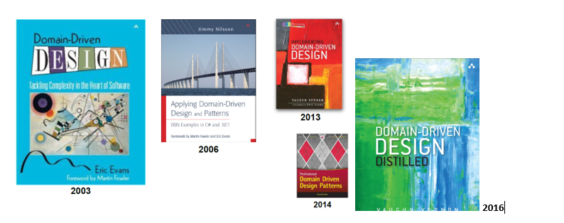
Books:
2003 - Domain-Driven Design: Tackling Complexity in the Heart of Software by Eric Evans
2006 - Applying Domain-Driven Design and Patterns: With Examples in C# and .NET by Jimmy Nilsson
2013 - Implementing Domain-Driven Design by Vaughn Vernon
2014 - Patterns, Principles, and Practices of Domain-Driven Design by Scott Millett
2016 - Domain-Driven Design Distilled by Vaughn Vernon

